Slide 2
Totally Amazing And Incredible Session Title Some Titles Are So Amazing They Are On Two Lines
SUPERDUPER SPEAKER
MVP OF ALL THINGS, EVER
CLOUD ARCHITECT, SUPER DUPER COMPANY

Slide 4

Azure Best Practices Architecting Complex Solutions with Heavy Loads
Damir Dobric

Slide 5


Damir Dobric daenet GmbH – ACP Digital Lead Software Architect Microsoft Regional Director Azure MVP https://damirdobric.me
Notes:
Single presenter
Each speaker introduces themselves and provides fun fact or superpower.

Slide 6
Agenda
Running jobs with large RAM consumption
Hosting Large Objects in Web
Q&A
https://github.com/ddobric/azure-bestpractices

Slide 7






Services used in this talk
docker
acr
batch
appervice
aci
az

Slide 8
Typical ML Project
Consuming the service
I.E.Model Prediction
Long running
I.E.: Model Training
JOB
Web Service

Slide 9
THE SECRET OF A DOCKER HYPE RUNNING OBJECTS WITH A LARGE RAM CONSUMPTION

Slide 10
Dynamic of RAM
Operative System
Physical memory Boundary
Process Private Memory
Process
Large Object(s) inside of process

Slide 11
Dynamic of RAM
Operative System
Virtual memory
Process Private Memory
Operative System
Physical memory Boundary
Process
Large Object(s) inside of process

Slide 12
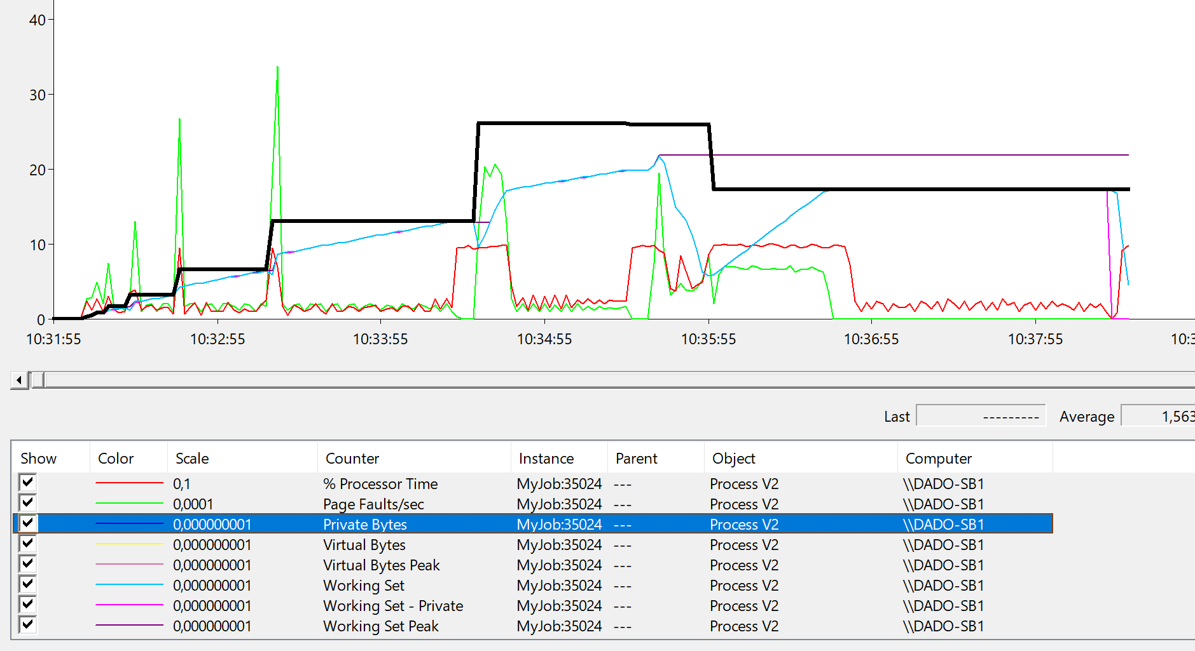
Run job locally

Slide 13
Run a job as a Docker Container
Run locally
> docker run -it --rm -m 8g myjob:latest
Tag image before pushing to ACR
> docker tag myjob:latest damir.azurecr.io/myjob:latest
> docker push damir.azurecr.io/myjob:latest
> az container create --resource-group 'my-container-apps' --name myjob --image vcddevregistry.azurecr.io/myjob:latest --m 8 --cpu 4 --restart-policy Never --os-type linux --registry-password RtMTAS+i2q1GkuYvFOIiRdRjpaxIAscF --registry-user vcddevregistry
Push to ACR
Run in ACI

Slide 14
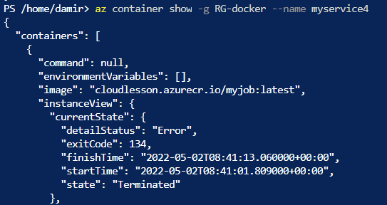
Killing my Docker softly
Inspect the container
Exit Code 134
Abnormal termination (SIGABRT)
Container Abnormally Terminated itself
Status Out of Memory
Exit Code 137
Immediate Termination (SIGKILL)
Docker Kill
Status OOMKilled

Slide 15
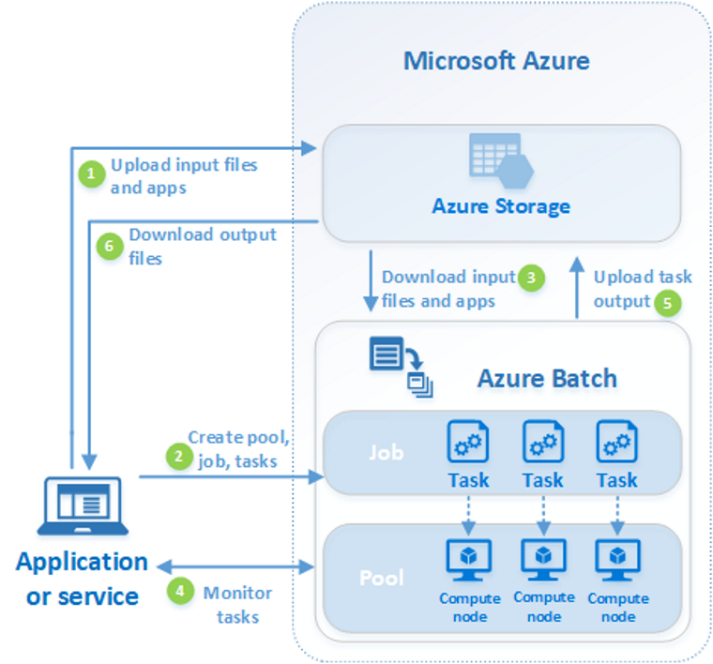
Azure Batch Service
We upload the job executable file to the storage. (2)
We create a task associated with executable file. (3)
We drive deployment from here (1)
We can scale over pool of reserved VMs.

Slide 16
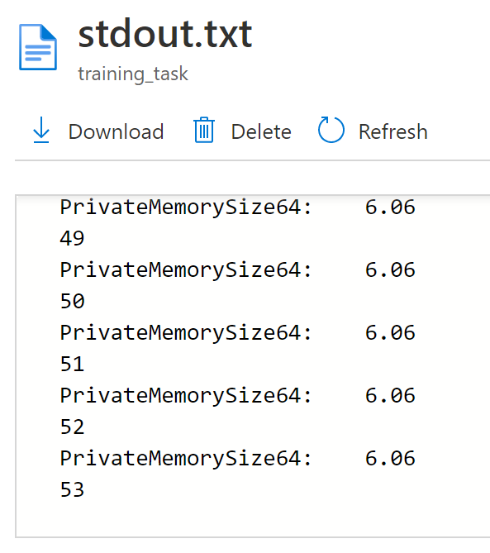
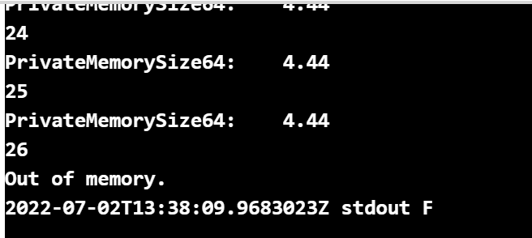




Docker vs. AzBatch with -–memory 8G
Docker in ACI and local
Azure Batch

Slide 17
HIDDEN PAINS OF CLOUD HOSTING LARGE OBJECTS IN WEB APPLICATIONS

Slide 18
API with large RAM consumption
var api = new MyApi(arg);
var res = await api.Run();

Slide 19
Locking for solution
Facts
Large APIs consume a lot of RAM
Not designed to run in the cloud
You want to run it as a service = REST service
Few API instances cannot serve many users
What to do?
Increase Vertically/Horizontally means an increase in costs
It is not easy to choose the right configuration
[HttpGet("{arg}")]
public async Task<string> Run(int arg)
{
var api = new MyApi(arg);
var res = await api.Run();
return res;
}
https://github.com/ddobric/azure-bestpractices

Slide 20
Processing of requests in ASP.NET WebApi
Thread
Object
Thread
Object
Thread
Object
Thread
Object
Thread
Object
Thread
Object
HTTPS Requests
Thread
Object
Thread
Object
Thread
Object
Thread
Object
Thread
Object
Thread
Object
Thread
Object
Thread
Object
[HttpGet("{arg}")]
public async Task<string> Run(int arg)
{
var obj = new MyApi(arg);
var res = await obj.Run();
return res;
}

Slide 21
Processing Large objects
Object
Thread
Object
HTTPS Requests
Thread
Object
Thread

Slide 22
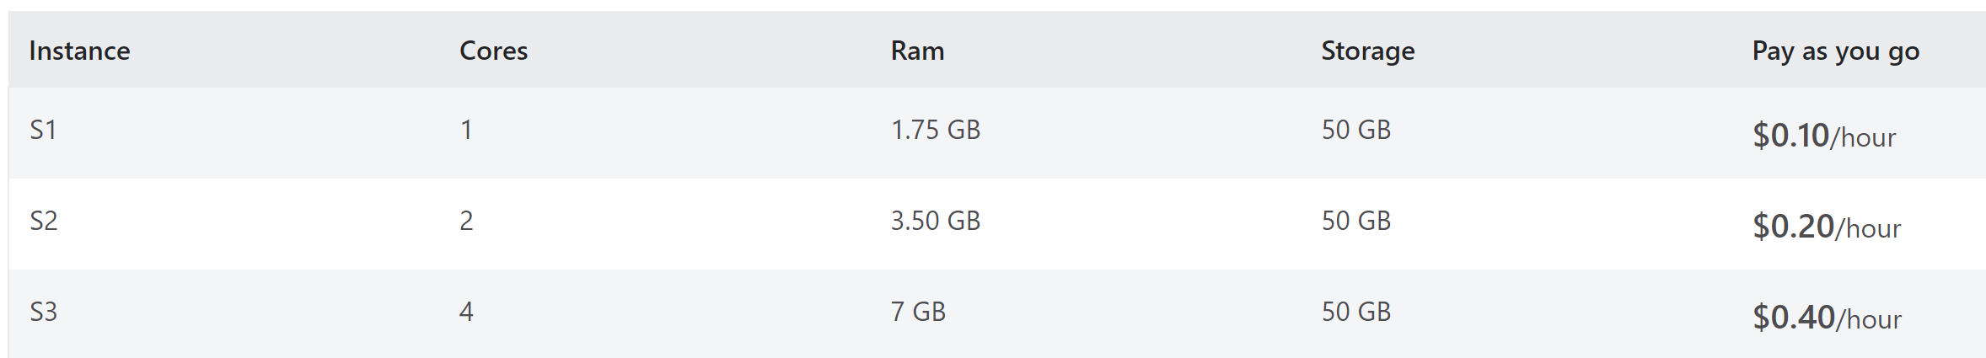
An example
Your API consumes (just) 1 GB RAM.
You have 100+ concurrent users.
2 instances in 3.5GB
100/2*144 EUR/month=7200 EUR/Month
(072)
(144)
(288)

Slide 23
THE OBJECT POOL PATTERN

Slide 24
Object Pool Pattern
ASP.NET WebApi
Thread 1
Object
Thread 2
HTTPS Requests
Object
Thread 3
Object
Thread 4

Slide 25
Object Pool Pattern
ASP.NET WebApi
Thread 1
Object
Thread 2
HTTPS Requests
Object
Thread 3
Object
Thread 4

Slide 26
Object Pool Pattern
ASP.NET WebApi
Thread 1
Object
Thread 2
Object
HTTPS Requests
Thread 3
Object
Thread 4

Slide 27
Object Pool Pattern
ASP.NET WebApi
Thread 1
Object
Thread 2
Object
HTTPS Requests
Thread 3
Object
Thread 4

Slide 28
RELATIVITY THEORY OF THE LOAD BALANCING

Slide 29

Cost Saving by prolonging request time
Memory (space)
Request processing (time)
SERVICE
Time Dilation
You can save the space if you slow dwn the processing time

Slide 30
WebServer will reject requests on high load
The server will reject requests with ERR:500 (Internal Server Error)
ASP.NET WebApi
Thread 1
Object
WebServer / ASP.NET
Request Queue
Thread 2
Object
Thread 3
Object
Thread 4
You take control and return custom busy error
ERR:410 (Gone)

Slide 31
Object Pool Pattern with the “request queue”
ASP.NET WebApi
Thread 1
Object
Thread 2
Object
HTTPS Requests
Thread 3
Object
Thread 4
machinelearning/ObjectPool.cs at 510f0112d4fbb4d3ee233b9ca95c83fae1f9da91 · dotnet/machinelearning (github.com)

Slide 32
Object Pool Pattern with “request queue”
ASP.NET WebApi
Thread 1
Object
Thread 2
Object
HTTPS Requests
Thread 3
Object
Thread 4

Slide 33
Object Pool Pattern with “request queue”
ASP.NET WebApi
Thread 5
Thread 2
Object
HTTPS Requests
Thread 3
Object
Thread 4
Object

Slide 34
This really works ☺

Slide 35
Summary
Large objects consume an unpredictable amount of RAM.
Docker Host terminates your code with Err 134 and 137.
Batch Service and VM are more tolerant
You can implement Object Pool = Large Objects as a Service
You can keep the size and costs, but you must slow down processing (time dilation).
https://github.com/ddobric/azure-bestpractices

Slide 36

Vielen Dank!
Vielen Dank für deine Teilnahme!
Dein Feedback ist uns wichtig!.​
Damir Dobric daenet GmbH – ACP Digital Lead Software Architect Microsoft Regional Director Azure MVP https://damirdobric.me
Notes:
For long resource links, create a shortened link at aka.ms
Paste the resource links into the meeting chat as an “Announcement” so attendees can copy/use them
To continue the conversation, re-post the team’s social handles or other methods of connecting
COPY/PASTE

Slide 37


twitter handle
BLOG URL

